Slide 1
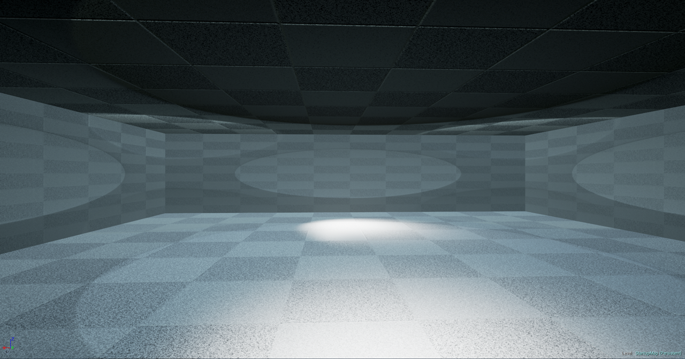




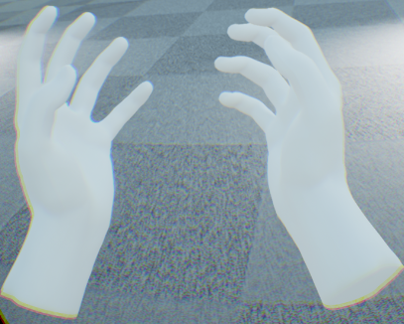

Virtual Scene

Slide 2




HUD Overlay – Menus

Slide 3

HUD Overlay – Drone Selection
MOVE
LAND

Slide 4


HUD Overlay – Drone Selection
MOVE
TAKE OFF
Notes:
<div>Icons made by <a href="http://www.flaticon.com/authors/yannick" title="Yannick">Yannick</a> from <a href="http://www.flaticon.com" title="Flaticon">www.flaticon.com</a> is licensed by <a href="http://creativecommons.org/licenses/by/3.0/" title="Creative Commons BY 3.0" target="_blank">CC 3.0 BY</a></div>

Slide 5



HUD Overlay – Multi-Drone Selection
MULTI
MOVE
MULTI
LAND

Slide 6





Action TAKE OFF for DRONE 5 REJECTED – path blocked
!
1
2
3
5
5
4
LAND
MOVE
TAKE
OFF
5
TKOFF

Slide 7











TKOFF
LAND
MOVE
TKOFF
MOVE
LAND

